Slide 1
Automatic checkout system
Sunday, September 6, 2020

Slide 2
目录 Contents
1
Introduction & algorithm
2
Automatic checkout system
3
Partially occluded object recognition
4
Robot grab

Slide 3
目录 Contents
1
Introduction & algorithm
2
Automatic checkout system
3
Partially occluded object recognition
4
Robot grab

Slide 4
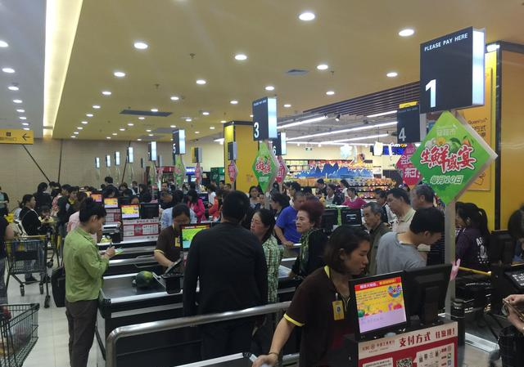
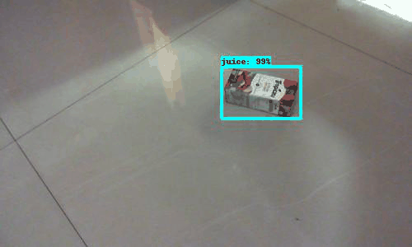
Introduction
Busy supermarket cashier
Computer Vision
Purpose:
save time
improve efficiency

Slide 5
Introduction
Algorithm
classical algorithm type：
one-stage：
two-stage：
YOLO
SSD
R-CNN
Fast R-CNN
Faster R-CNN
high speed
high accuracy
Notes:
相比Yolo，SSD采用CNN来直接进行检测，而不是像Yolo那样在全连接层之后做检测。其实采用卷积直接做检测只是SSD相比Yolo的其中一个不同点，另外还有两个重要的改变，一是SSD提取了不同尺度的特征图来做检测，大尺度特征图（较靠前的特征图）可以用来检测小物体，而小尺度特征图（较靠后的特征图）用来检测大物体；二是SSD采用了不同尺度和长宽比的先验框（Prior boxes, Default boxes，在Faster R-CNN中叫做锚，Anchors）。

Slide 6
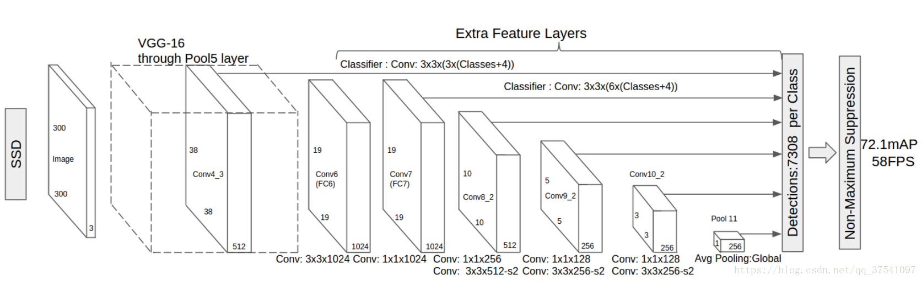
Introduction
Algorithm
SSD : Single Shot Multi Box Detector
network structure diagram of the SSD
Notes:
相比Yolo，SSD采用CNN来直接进行检测，而不是像Yolo那样在全连接层之后做检测。其实采用卷积直接做检测只是SSD相比Yolo的其中一个不同点，另外还有两个重要的改变，一是SSD提取了不同尺度的特征图来做检测，大尺度特征图（较靠前的特征图）可以用来检测小物体，而小尺度特征图（较靠后的特征图）用来检测大物体；二是SSD采用了不同尺度和长宽比的先验框（Prior boxes, Default boxes，在Faster R-CNN中叫做锚，Anchors）。

Slide 7
Introduction
Algorithm
SSD : Single Shot Multi Box Detector
process flow ：
Prior box matching
Loss function
Data amplification
Forecasting process
Performance evaluation
Notes:
相比Yolo，SSD采用CNN来直接进行检测，而不是像Yolo那样在全连接层之后做检测。其实采用卷积直接做检测只是SSD相比Yolo的其中一个不同点，另外还有两个重要的改变，一是SSD提取了不同尺度的特征图来做检测，大尺度特征图（较靠前的特征图）可以用来检测小物体，而小尺度特征图（较靠后的特征图）用来检测大物体；二是SSD采用了不同尺度和长宽比的先验框（Prior boxes, Default boxes，在Faster R-CNN中叫做锚，Anchors）。

Slide 8
目录 Contents
1
Introduction & algorithm
2
Automatic checkout system
3
Partially occluded object recognition
4
Robot grab

Slide 9
Automatic checkout system
Implement
Data preparation
to generate our own datasets and make labels
Perform training
to modify the default training script content of SSD to match our own dataset
Testing
to test different combinations of several types of items.

Slide 10
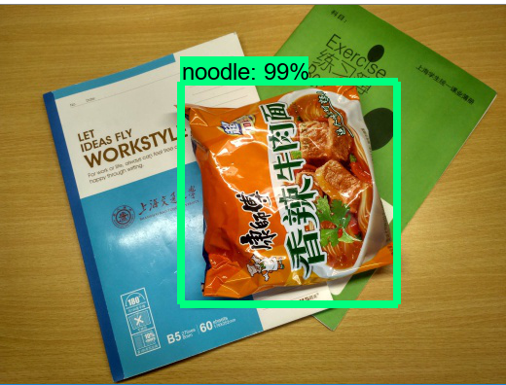
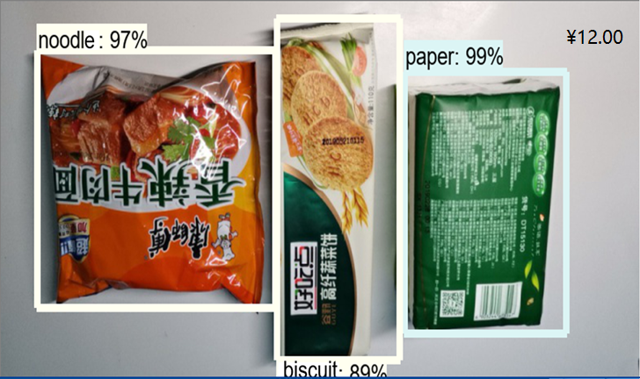
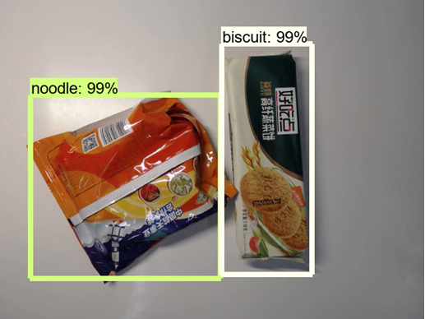
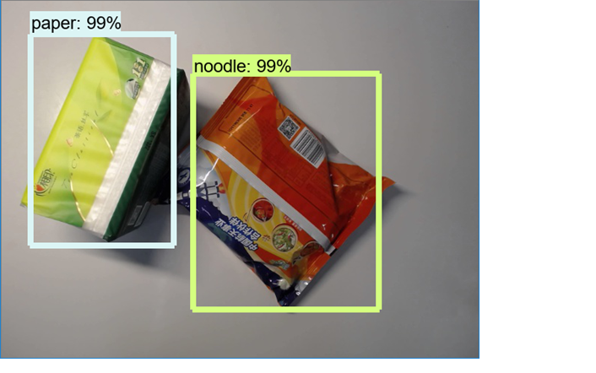
Automatic checkout system
Results
￥ 3.00
+
￥ 3.00
+
￥ 6.00
=
￥ 12.00

Slide 11
目录 Contents
1
Introduction & algorithm
2
Automatic checkout system
3
Partially occluded object recognition
4
Robot grab

Slide 12
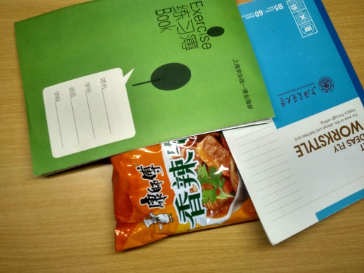
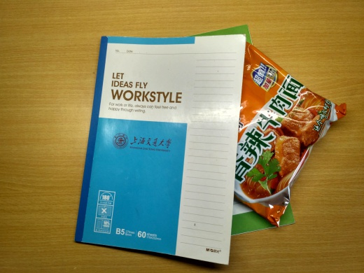
Partially occluded object recognition
Question
However, in real life, there is often a situation where an item is covered by other items. Can the results of our training still apply to the this situation?
No!

Slide 13
Partially occluded object recognition
Solution
some tricks of SSD：
Data augmentation
Default box
Hard negative mining

Slide 14
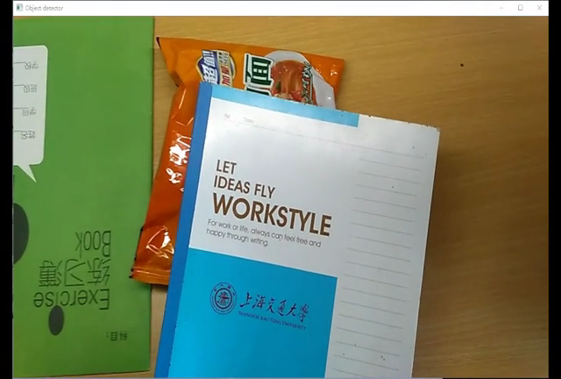
Partially occluded object recognition
Result

Slide 15
目录 Contents
1
Introduction & algorithm
2
Automatic checkout system
3
Partially occluded object recognition
4
Robot grab
Notes:
第四部分由我为大家介绍两钟数控机床的故障诊断方法，这次报告的主题是高端数控机床的检测，但是检测的目的是了解数控机床的状态并且对故障进行诊断定位

Slide 16
Robot grab
Content
a) Object detection model training
b) Template generation
c) Point cloud matching
d) Visual system calibration
e) Experimental result

Slide 17
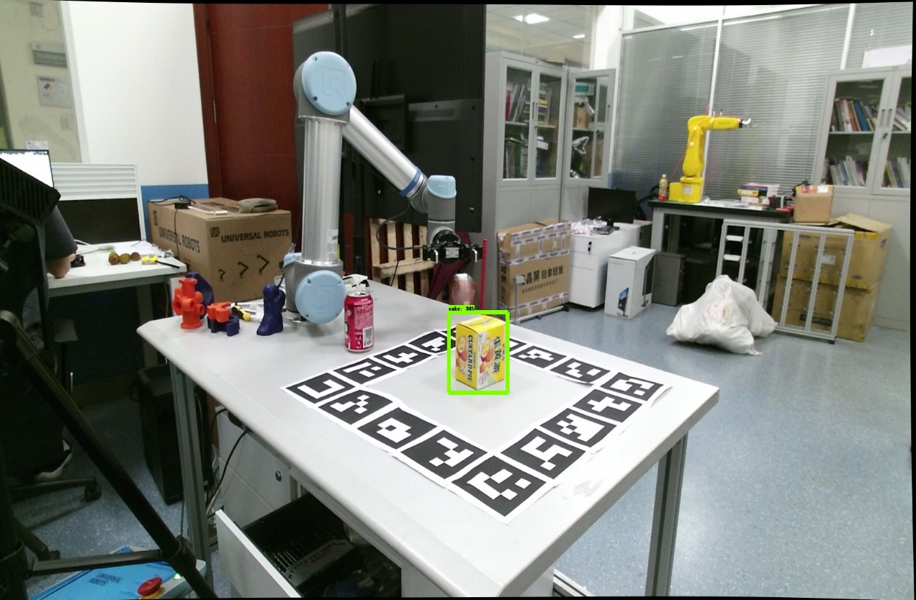
Robot grab
Object detection model training
We use SSD algorithm to train the object detection model for snacks grasping with approximately 100 pieces of images for each class.

Slide 18
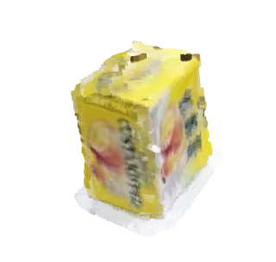
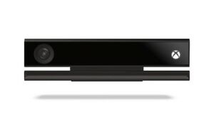
Robot grab
Template generation
In order to get templates for each target item, we use 3D reconstruction through capturing pairs of RGB image and depth image around each entity.
Our experiment was based on Kinect v2 RGBD camera.

Slide 19
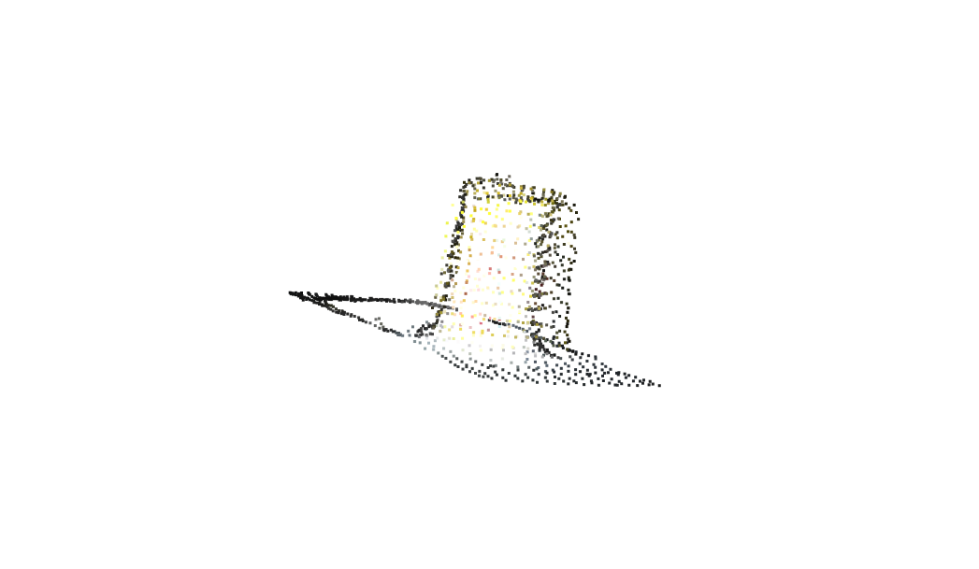
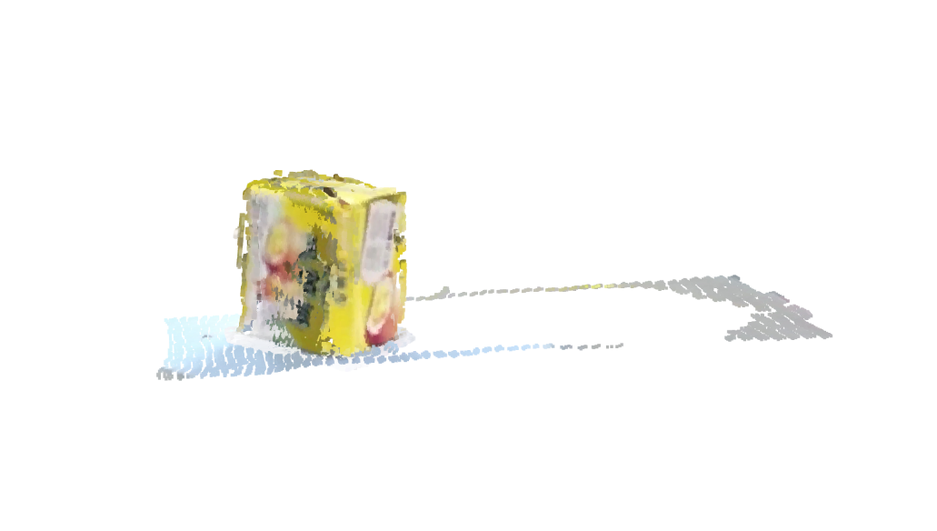
Robot grab
Point cloud matching
Rough registration based on FPFH descriptor after down sampling.
Refining registration based on Point-to-Plane iteration.

Slide 20

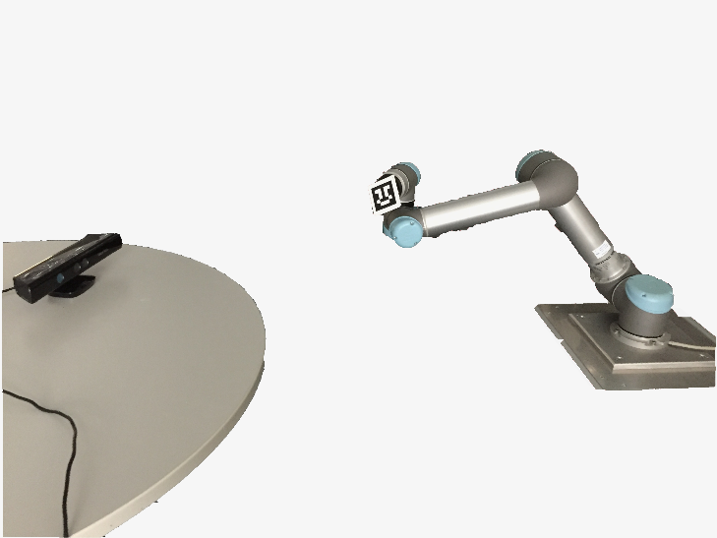
Robot grab
Visual system calibration
We use 5x7x0.03 checkerboard to calibrate Kinect v2 RGBD camera we used.
Considering Kinect v2 is too large for being fixed on end effector, we adopt Eye-on-Base way for Hand-Eye Calibration.

Slide 21
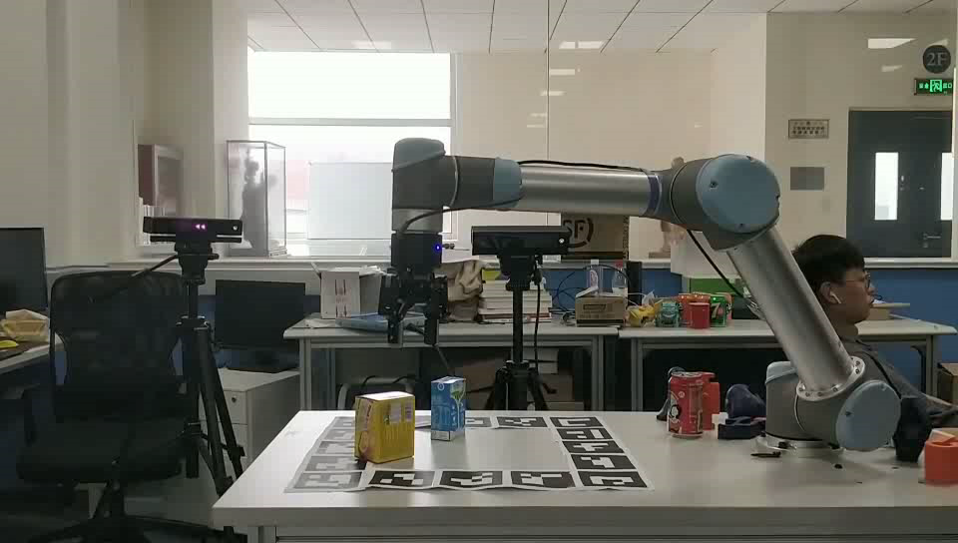
Robot grab
Experimental result
X3

Slide 22
Reference
[1] Xinlong Wang, Tete Xiao, Yuning Jiang, Shuai Shao, Jian Sun, and Chunhua Shen. Repulsion loss: Detecting pedestrians in a crowd. In CVPR, 2018.2
[2] Shifeng Zhang, Longyin Wen, Xiao Bian, Zhen Lei, and Stan Z Li. Occlusion-aware r-cnn: Detecting pedestrians in a crowd. In ECCV, 2018. 2
[3] Xiu-Shen Wei, Quan Cui, Lei Yang, Peng Wang, and Lingqiao Liu. RPC: A large-scale retail product checkout dataset. arXiv preprint arXiv:1901.07249, 2019. 1
[4] W. Liu, D. Anguelov, D. Erhan, C. Szegedy, S. Reed, C.-Y. Fu, and A. C. Berg. SSD: Single shot multibox detector. In ECCV, 2015. 2, 3

Slide 23
Thanks！

